Slide 1
Designing Intelligent Agents: Evaluating Intelligence
Colin Johnson

Slide 2
Artificial (General) Intelligence
Artificial Intelligence:
“The capacity of computers or other machines to exhibit or simulate intelligent behaviour; the field of study concerned with this.” (OED)
“the theory and development of computer systems able to perform tasks normally requiring human intelligence, such as visual perception, speech recognition, decision-making, and translation between languages” (Oxford Living Dictionary)
Artificial General Intelligence
“Artificial General Intelligence (AGI) would be a machine capable of understanding the world as well as any human, and with the same capacity to learn how to carry out a huge range of tasks.” (Nick Heath)
Some problems are AI-hard aka AI-complete, meaning that there is no way to solve those individual problems in isolation without building a full AGI system.
Clearly a pun on complexity classes—but, doesn’t have a formal definition unlike NP-hard etc.
https://www.zdnet.com/article/what-is-artificial-general-intelligence/

Slide 3
Evaluating Intelligence
How do we evaluate (artificial) intelligence?
Evaluating human intelligence is difficult, fraught and has political/cultural dimensions
What counts as “intelligent” behaviour?
Is there a single thing that counts as intelligence?
What about analytical/linguistic/mathematical/cultural/emotional/spiritual/creative intelligence? Are these all aspects of “intelligence” or are they attempts to shoehorn lots of other human characteristics into “intelligence”?
How can we make evaluations of intelligence less culturally biased? Can a culture-free intelligence test be devised at all

Slide 4
Evaluating Intelligence
In AI, we don’t typically ask the question of “how intelligent is a system”
…largely because, contrasted with the public image, we don’t really try to build “an AI”, but we write task-specific programs
…and therefore, the measure of the performance is the performance on that task
usually, the system is trained from scratch on that task rather than in context of wider learning
…though this is shifting with systems such as LLMs that attempt to learn from a vast corpus of knowledge.
More recently, there has been more focus on transfer learning, that is, taking a system that has been trained on one task, and seeing if that learning can “transfer” elsewhere.
a canonical example is work in computer vision (e.g. inception, VGG-16, Xception)
the idea here is to take a vision system trained on a wide variety of images, and transfer that “general knowledge” about how to classify and interpret visual scenes and apply it to a specific task
the measure now is “how well does that system work with the input of knowledge from the transferred system, against learning from scratch”

Slide 5
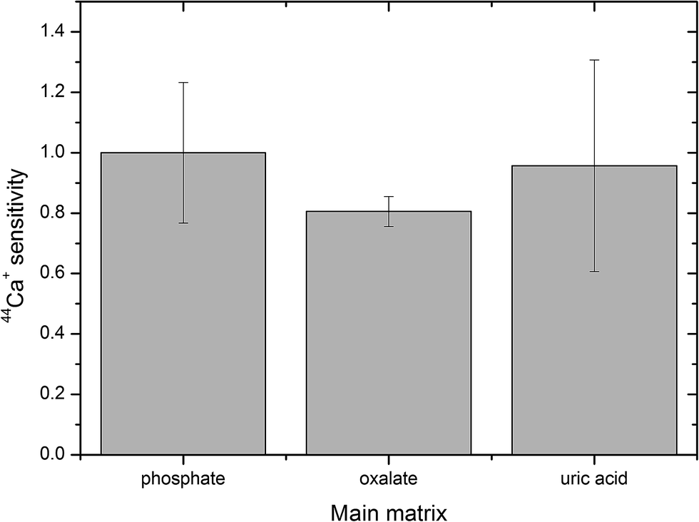
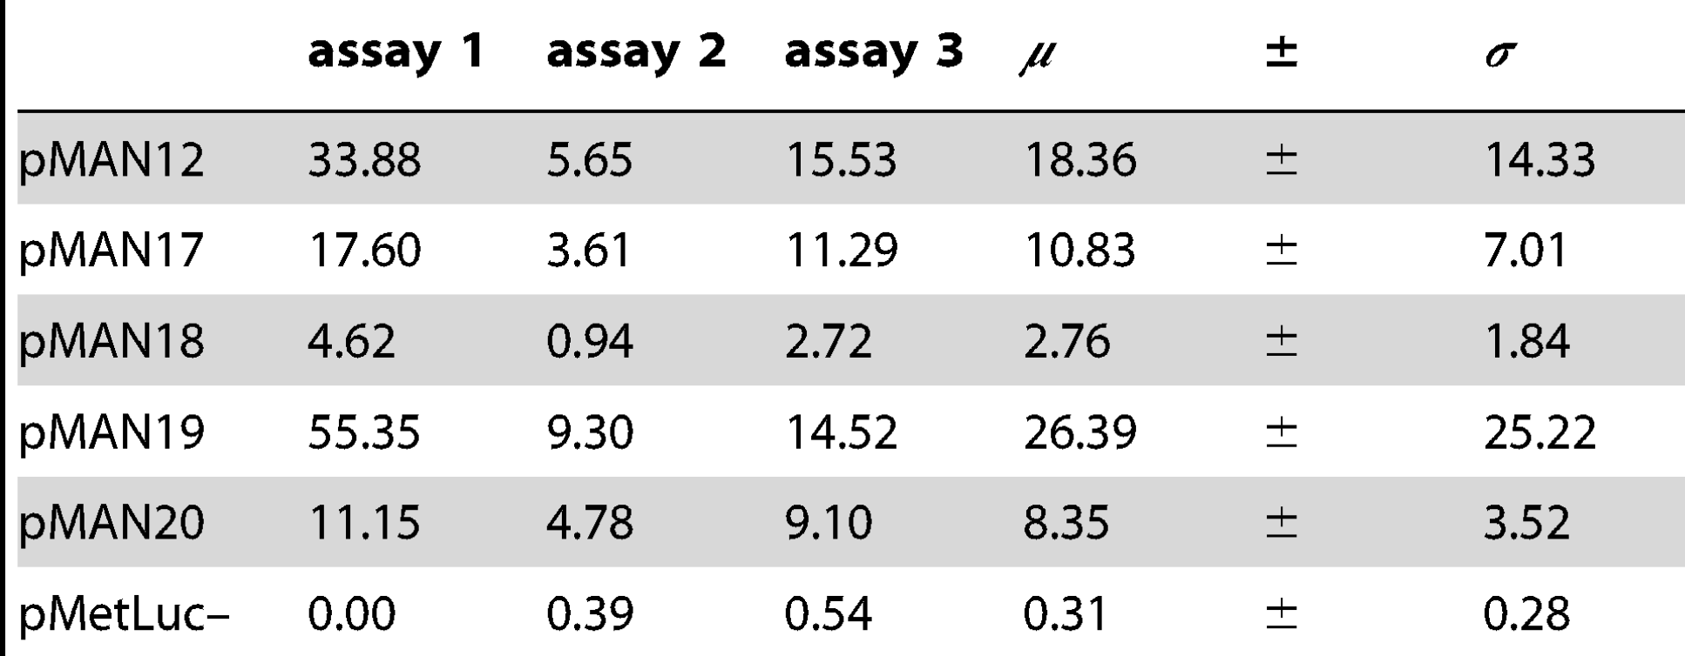
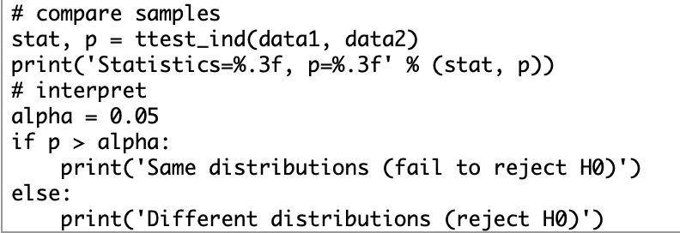
Evaluating Task Performance (Objective Measures)
Typically one or more numerical measures, e.g.:
accuracy
speed
bar chart with error bars of one s.d.
Comparison of difference conditions by mean and standard deviation:
t-test to compare means
https://machinelearningmastery.com/parametric-statistical-significance-tests-in-python/
https://journals.plos.org/plosone/article?id=10.1371/journal.pone.0078205
https://www.biologyforlife.com/interpreting-error-bars.htmla

Slide 6
What if the task is more subjective?
Consider an agents that does something like having a conversation or writing a poem.
How can we evaluate something subjective like this?
Various approaches use user feedback from a number of people to map out that subjectivity
You might want to do this for your coursework, but clearly given time constraints you won’t have time to do a large-scale participant study
This could be asking people to rate the quality of the outputs/interactions
perhaps on a number of dimensions: enjoyability, writing quality, emotional engagement, novelty
…and/or, you could ask people to describe the outputs/interactions in words and then do a (lightweight) “thematic analysis” where you pull out common themes.
Alternatively, Turing test type evaluations:
that is, contrasting the computer on the task with humans doing the task

Slide 7
Evaluating Creative Intelligence
What dimensions are there to this kind of creative intelligence?
Clearly there is an aspect of novelty
implicit in “creative intelligence” is the idea of “something new”
…but this isn’t everything. (Meaningless) novelty is easy.
So, we might also want to evaluate the value aka quality of the outputs
…is this a good example of that kind of creative intelligence
...and perhaps also:
skill—is the system demonstrate a mastery in its area
imagination—is the system extending beyond existing examples
appreciation—does the system seem to understand what is it doing
independence—are the ideas that it generates different to its inputs, does it “add value”
http://www.thepaintingfool.com/papers/colton_aaai08symp.pdf

Slide 8
Exemplars for AGI
Over the years, people have suggested that such-and-such might be an exemplar for intelligence, in the sense that “if a computer can do…then it must surely be generally intelligent”
or, more softly, “…artificial general intelligence must surely be around the corner”
These have typically turned out to be nonsense
people have moved on—“if computers can do it…well, then, it clearly isn’t that intelligent, innit”
Let’s consider three examples…then we will break into groups to discuss this.

Slide 9
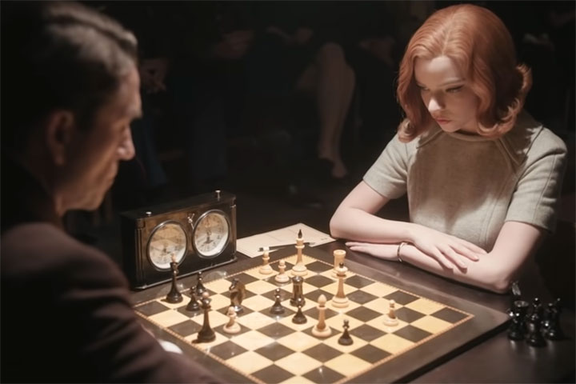
Chess
“if a computer can play chess well, then surely we must regard it as intelligent, because chess is something that requires lots of intelligence and study to do well”

Slide 10
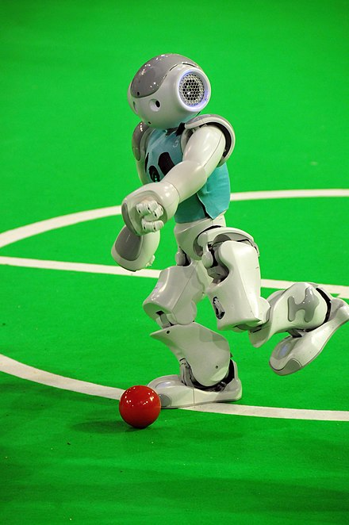
Football
“chess is easy; but, if a computer can play football well, then surely we must regard it as intelligent, because football is something that requires lots of practice and skill development to do well, and it has to deal with so many more real-world difficulties than chess”

Slide 11
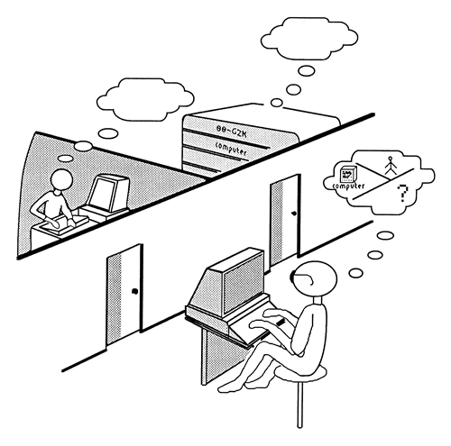
Conversation (the Turing test etc.)
“all these sports and games are very well, but if a computer can have a convincing conversation then surely it must be intelligent”
(echoes of the original Turing test–i.e. can a computer, communicating by text only, over five minutes, have a sufficiently convincing wide-ranging conversation so that it is indistinguishable from a conversation with a person)
Ann Witbrock; from Copeland, B.J., Artificial Intelligence Blackwell Publishers, Oxford, 1993.)

Slide 12
Task
Three exemplars:
“if a computer can play chess well, then surely we must regard it as intelligent, because chess is something that requires lots of intelligence and study to do well”
“chess is easy; but, if a computer can play football well, then surely we must regard it as intelligent, because football is something that requires lots of practice and skill development to do well, and it has to deal with so many more real-world difficulties than chess”
“all these sports and games are very well, but if a computer can have a convincing conversation then surely it must be intelligent”
Are any of these arguments convincing? What aspects of general intelligence do they demonstrate? What ways are these tasks limited in a way that means that they are not demonstrations of general intelligence?

Slide 13
Summary
Artificial general intelligence
Evaluating intelligence:
for objectively defined measures
for subjective and creative topics
Exemplars for intelligence

